Slide 1

REACH & CLP
Downstream user overview

Slide 2
Purpose of this presentation
This presentation, with notes, was prepared by ECHA, the European Chemicals Agency, to assist you in preparing a presentation about REACH and CLP Regulations relating to downstream users. The intention is that you can select relevant slides and modify them as necessary to suit your audience, whether it is management, workers, environmental health and safety professionals, authorities etc. You may use it without additional permission.
This presentation gives a brief overview of the main downstream user obligations, communication in the supply chain and the regulatory impact regarding substances of concern. It forms part of a series of presentations relating to downstream users and REACH/CLP, which are on the ECHA website. We welcome your comments and suggestions at downstream_users@echa.europa.eu.
Legal notice: The information contained in this presentation does not constitute legal advice and does not necessarily represent in legal terms the official position of the European Chemicals Agency. The European Chemicals Agency does not accept any liability with regard to the contents of this document.
Release: February 2015, Last update: July 2019

Slide 3
Contents
Overview of legislative background
Downstream users under REACH and CLP
Communication in the supply chain
Information on chemicals
Chemicals of concern
Overview of key actions for downstream users under REACH and CLP
Notes:
This presentation, which forms part of a series, gives a general overview and introduction to key elements related to downstream users and is aimed at a wide range of audiences, including management, workers, environmental health and safety professionals, industry groups, national and local authorities etc.

Slide 4

Overview of legislative background

Slide 5

Aims of REACH and CLP
Ensure a high level of protection of human health and the environment
Ensure promotion of alternative methods for assessment of hazards of substances
Ensure the free movement of chemicals
Enhance competitiveness and innovation

Slide 6
Key elements of REACH
Registration, Evaluation, Authorisation and Restriction of Chemicals (EC) No 1907/2006
Substances manufactured and imported into EEA are registered with ECHA
Information for safe use is communicated in the supply chain
Registration
Examination of registrant testing proposals
Compliance check of registration dossiers
Evaluation of substances
Evaluation
Regulatory Risk
Management
Authorisation
Restriction
Harmonised classification
Notes:
Registration dossiers for substances manufactured or imported above 1 tonne/year are submitted to ECHA by industry. These contain the classification, information on the uses, substance properties etc. Substances registered above 10 tonnes/year also include a hazard and risk assessment, in what is called a chemical safety report (CSR).
Evaluation by ECHA and the Member States includes examination of testing proposals, to prevent unnecessary animal testing. It also covers both registration dossier compliance check and substance evaluation, which are two distinct processes. Dossier compliance check acts as a quality check of registration dossiers by authorities, and at least 5% of each tonnage band is scrutinised by ECHA. Substance evaluation is a process run by Member State Authorities, and in a nutshell it aims at clarifying whether a given substance poses a risk to human health or the environment and whether further actions are necessary. The starting point is the information in the registration dossier of that substance, but MS may require further information on the substance beyond the REACH information requirements in the process.
Authorisation, restriction and harmonised classification are the regulatory risk management measures processes included in REACH. Communication in the supply chain is a vital element for the safe use of chemicals
(See DU guidance section 1 for an overview of REACH process from a DU standpoint https://echa.europa.eu/documents/10162/23036412/du_en.pdf/)

Slide 7
Key elements of CLP
Classification, Labelling and Packaging Regulation (EC) No 1272/2008
Classify
Manufacturers, importers and downstream users classify substances and mixtures
Label and package
Suppliers label and package them in accordance with CLP
Manufacturers, importers and downstream users notify substance to ECHA’s classification and
labelling inventory
Suppliers communicate information to
Poison Centres
Communicate
CLP implements UN Globally Harmonised System
The classification of certain substances is harmonised
Harmonise
Notes:
Classify : A classification inventory has been built for over 120,000 substances, from over 6 million notifications
Harmonise: Most substances and all mixtures are self classified, but more hazardous substances have agreed, harmonised, classification at EU level

Slide 8
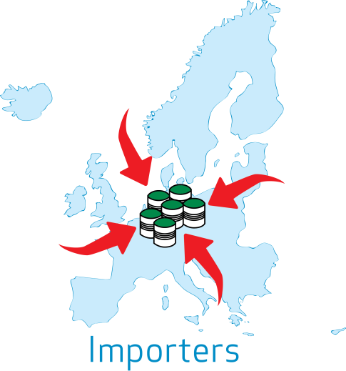




Main roles of industry in REACH & CLP
Manufacturer: manufactures a substance
Importer: imports chemicals from outside the
EEA
Downstream user: uses chemicals,
e.g.: formulates, transfers or
uses mixtures, produces articles
Distributor: stores or distributes chemicals
A company may have multiple roles – the role depends on the activity being undertaken with a given substance
Notes:
One company may have multiple roles in REACH and CLP, and this slide describes the main ones. Depending on its activities, possible roles for a company can be manufacturer, importer, downstream user and distributor. (See DU Guidance section 2, https://echa.europa.eu/documents/10162/23036412/du_en.pdf/).
REACH applies in the EEA, which is EU plus countries Norway, Iceland and Liechtenstein. This means that imports from these countries are not considered imports for the purposes of REACH. An importer of a substance from Iceland, Liechtenstein or Norway is simply regarded as a distributor or downstream user.

Slide 9

REACH/CLP and other EU chemicals legislation
REACH and CLP work together with other EU/national legislation such as:
Chemical agents at work Directive 98/24/EC
Carcinogens or mutagens at work: Directive 2004/37/EC
Industrial emissions Directive 2010/75/EU
Biocidal Products Regulation 528/2012
Notes:
The information provided in REACH registration and in the classification inventory can assist industry in compliance with requirements under other chemicals legislation. Similarly, information from activities undertaken under other EU legislation, such as monitoring, risk assessment etc. can help to improve the quality of the registration dossiers and chemical safety reports, for example by enabling downstream users to provide information on good practice of their use(s) of substances upstream to their suppliers.

Slide 10

REACH, CLP and users of chemicals

Slide 11



Who is a downstream user under REACH/CLP?
User of chemicals are termed downstream users under REACH and CLP. They are companies or individuals
within the European Union / European Economic Area
who use a substance, either on its own or in a mixture
in industrial or professional activities
They can be formulators and end users, including producers of articles
Notes:
Under REACH a “use” is almost any activity carried out with a substance as such or in a mixture. This is how it is defined under REACH (Article 3(24)): Use: means any processing, formulation, consumption, storage, keeping, treatment, filling into containers, transfer from one container to another, mixing, production of an article or any other utilisation;
Industrial activity: This refers to an industrial site, covering a wide range of production
Professional activity: This includes craftsmen, and service providers that may or may not have a fixed workplace / workshop.
Examples of such users are flooring contractors, mobile cleaning companies, professional painters, construction companies, farmers, and users of lubricants for equipment such as chainsaws.
Note: the terms “industrial” and “professional” are used in exposure estimation tools to reflect the level of good occupational hygiene practice that is implemented, and not necessarily the activity itself.

Slide 12




Formulators
Formulators produce mixtures, which are usually supplied further downstream
Examples of mixtures: paints,
lubricants, cleaning products and adhesives
…are downstream users
Notes:
For more information for formulators, see http://echa.europa.eu/regulations/reach/downstream-users/who-is-a-downstream-user/formulators

Slide 13


End users
End users use substances or mixtures but do not supply them further downstream
Examples: users of chemicals reagents, coatings and inks, construction chemicals, metal working fluids, cleaning agents and adhesives
…are downstream users

Slide 14



Producers of articles
Producers of articles are end users and incorporate substances or mixtures into articles (components, finished goods and complex products)
Examples: producers of textiles, vehicles, toys, jewellery and household appliances
…are downstream users
Notes:
What is an article under REACH?
Article 3(3) of the REACH Regulation defines an article as “an object which during production is given a special shape, surface or design which determines its function to a greater degree than its chemical composition”. For examples see e.g. section 2.4 of the Guidance on Substances in Articles (https://echa.europa.eu/documents/10162/23036412/articles_en.pdf).
A complex products is a products made up of more than one article.

Slide 15

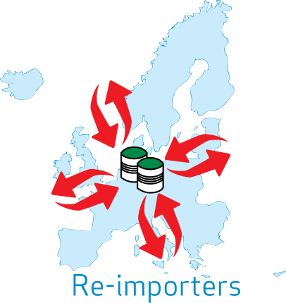

Re-fillers, re-importers and certain importers
Refiller: transfers substances or mixtures from one container to another (such as repackaging or rebranding)
Re-importer: imports a substance, on their own or in a mixture, which was originally produced in the EU, and the substance was registered by someone in the same supply chain
Importer with ‘only representative’ – imports a substance from outside the EU, but the non-EU supplier nominated an EU based ‘only representative’
…are downstream users
Notes:
What is an only representative?
Substances imported into the EU on their own, in mixtures or, under certain conditions, in articles need to be registered by their EU importers. This implies that each individual importer needs to register the substance(s) he imports.
However, under REACH, a natural or legal person established outside the EU, who manufactures a substance, formulates a mixture or produces an article can appoint an only representative to carry out the required registration of the substance that is imported (as such, in a mixture or in an article) into the EU (Article 8(1)).
When an only representative is appointed, the EU importers within the same supply chain are relieved of their registration obligations, and are regarded as downstream users.
It should be noted that REACH applies in the EEA, which is EU plus countries Norway, Iceland and Liechtenstein. This means that imports from these countries are not considered imports for the purposes of REACH. An importer of a substance from Iceland, Liechtenstein or Norway is simply regarded as a distributor or downstream user

Slide 16


Who is NOT a downstream user under REACH/CLP?
Distributors (including retailers) who store and place chemicals on the market for third parties.
REACH and CLP obligations are limited to forwarding information in the supply chain.
Consumers do not have any obligations
under REACH and CLP.
…are NOT downstream users
Notes:
Who are distributors?
They store and place substances (as such or in mixtures) on the market.
A person who solely stores and places articles on the market for third parties is not a distributor according to the definition in the REACH Regulation.
What are distributors’ main obligations?
Main obligation under REACH is to pass on information on the goods you distribute from one actor in the supply chain to another.
This includes safety data sheet for substances and mixtures.
Furthermore, there is a requirement for certain information to be provided for substances, mixtures or articles when a safety data sheet is not required.
See Appendix 1 in the DU Guidance for more information on distributors

Slide 17




Distributors
Distributors sometimes do more than store and place a substance on the market, and these additional activities may give rise to obligations under REACH and CLP
If distributors use chemicals, for example if they blend or re-fill the substances or mixtures
… they are also downstream users
If distributors import hazardous chemicals from outside the EU
… they are also importers
Notes:
The term ”distributor” under REACH/CLP is quite limited and specific, as defined in the previous slide. The term ”distributor” is often used in business to describe a company that undertakes a lot more activities than the REACH definition. If so, they are likely to be also downstream users, and/or importers
Note on import: If there is a nominated only representative, a company (distributor) importing is a downstream user (see slide 15)

Slide 18

Communication in the supply chain
Safety Data Sheets and Exposure Scenarios

Slide 19
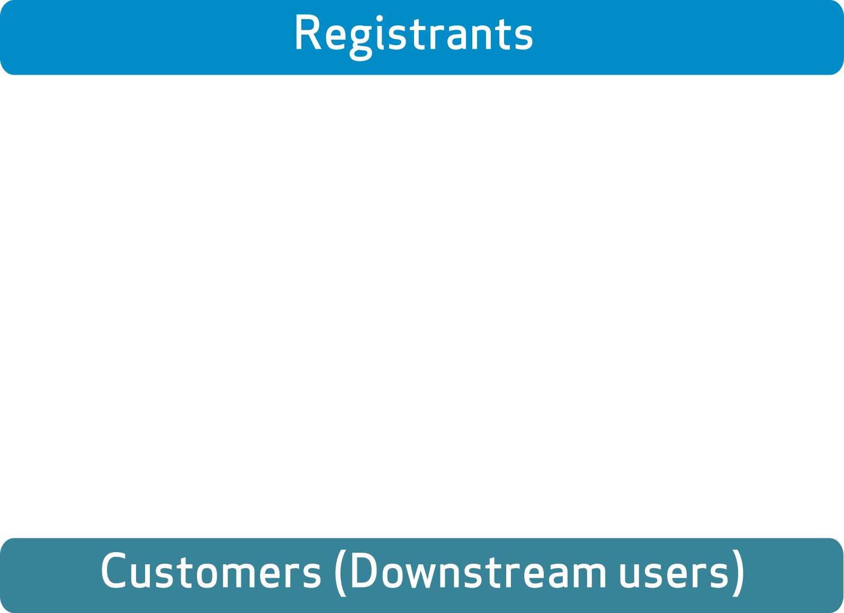




Communication in the Supply Chain
Notes:
Who is to prepare and provide which information in the supply chain?
The registrant of a substance is obliged to prepare the registration dossier, and for substances that are manufactured or imported more than 10 tonnes per year, this includes also the chemical safety report.
The registrants are required to assess the use of the substance throughout its life cycle. Therefore, as a first step, he needs to gather information on the uses of his substance in the supply chain, for example, from his customers.
Registration dossier and the CSR document the conditions of safe use. Exposure scenarios were introduced with REACH, and they document conditions of safe use for specific uses or groups of uses. Exposure scenarios submitted to ECHA are expected to contain thorough justifications for the information that is included.
CSR remains with ECHA, while the safety data sheet, which should contain information which is consistent with the CSR, is the vehicle to communicate information on safe use to the customers.
Safety data sheets, may include exposure scenarios. Exposure scenarios for communication are expected to be simpler than ES submitted to ECHA, and they should concentrate on outlining in a clear manner the operational conditions and risk management measures which result in safe use of that substance. The use of standard formats and phrases is recommended.
ECHA has published annotated templates and illustrative example on ES for communication (http://echa.europa.eu/support/guidance-on-reach-and-clp-implementation/formats)

Slide 20

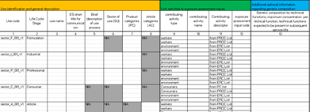
The downstream user role –
Communication in the Supply Chain
Better information to registrants results in better advice on safe use from suppliers
Information to registrants is usually via “use maps” that sector organisations generate to describe the most common uses
Make sure your sector is involved and include information on your uses
If you have new information on hazards or inappropriate risk management measures in the safety data sheet, you must communicate it to your supplier
Sector Use Maps
Notes:
Communicating uses to the registrants
Downstream users have the right to inform their uses to the registrants in order to have them included in the registrant’s CSR. The registrant, however, may decide not to take them on board.
The information flow is most efficiently managed by sector associations, and they have developed use maps to cover typical uses and conditions of use in their sector. Individual companies should contact their sector organisation as a first step.
When there is a need to inform a registrant about your own use directly, harmonised templates should be used in order to standardise the communication flow.
For more information on use maps, see https://echa.europa.eu/csr-es-roadmap/use-maps/concept

Slide 21




The safety data sheet (SDS)
REACH defines
When a SDS must be provided
What to do when you receive a SDS
What a SDS should contain
The format of a SDS
When exposure scenarios should be annexed
Classification and labelling information must be provided in accordance with the CLP Regulation
Notes:
The communication requirements are defined in Title IV of REACH. The format or content of a safety data sheet is specified in annex II. A use friendly description of safety data sheets, exposure scenarios and what to do when you receive it is provided in this guide https://echa.europa.eu/safety-data-sheets-and-exposure-scenarios-guide.

Slide 22
When to expect a safety data sheet (SDS)
When substance or mixture is hazardous
  Substance or mixture is classified as hazardous
  Substance is PBT/vPvB
  Substance is on Candidate List
  Non-classified mixture contains certain substances above specified limits (to be provided on request)
It is sold to downstream user(s)
  SDS are not required for the general public
  Sufficient information for safe use must be provided when an SDS is not provided
  If a substance or mixture is sold to both downstream users and general public, SDS need not be supplied, unless requested by downstream user or distributor
Or it has been requested
Notes:
Candidate List: Substances of concern for human health and/or the environment can be identified and subsequently regulated to make sure that the risks associated with the use of these substances are properly controlled. One regulatory mechanism under REACH is authorisation. A substance identified as a substance of very high concern (SVHC) is placed on the Candidate List, which is the first step in the authorisation procedure. See http://www.echa.europa.eu/candidate-list-table
PBT/vPvP: persistent, bioaccumulative and toxic or very persistent and very bioaccumulative

Slide 23
When to expect an exposure scenario (ES)
When it is a substance
  Exposure scenarios are included as an annex to the safety data sheet for substances.
  For mixtures, the supplier may communicate the information from exposure scenarios for ingredient substances in a number of ways
And registered > 10 tonnes/year
  The substance is registered, and a chemical safety assessment is required on registration because the quantity manufactured or imported by the registrant, exceeds 10 tonnes per year
  The substance is classified as hazardous or is PBT/vPvB
And it is hazardous
Notes:
NOTE: A supplier is required to provide relevant ES for a registered, hazardous, substance. For a mixture, the supplier may communicate the information in several ways. He may consolidate the information into (i) an annex of safe use information for the mixture or (ii) the main body of the SDS or he may provide ES for ingredient substances with a SDS.
A difficulty in knowing when to expect an exposure scenario is that you do not know the quantity manufactured or imported by the registrant.
PBT/vPvP: persistent, bioaccumulative and toxic or very persistent and very bioaccumulative

Slide 24
What to do when you receive an extended safety data sheet (SDS+ES)
Apply appropriate measures from SDS
  The main information relating to risk management is in Sections 7, 8 and 9 of the SDS and in Section 3 of the ES
Check your use is covered in the ES
  Your use should be included and your conditions of use should match those in the exposure scenario from your supplier
  Otherwise, contact or change your supplier to have your use covered, or take alternative action
Implement ES conditions of use
Notes:
Note that you are obliged to identify and apply appropriate measures from the SDS but you are obliged to implement the measures from the exposure scenario or take alternative action. Therefore you need to check the ES carefully.
What do you need check in the exposure scenario:
That your use is covered (= that the registrant/supplier has assessed conditions of safe use)
That your conditions of use fall into the boundaries expressed in the exposure scenario for that use)
If this is not the case you need to take alternative action, e.g.
Ask your supplier to include your use
Change operational conditions/risk management measures so that they are covered by the exposure scenario
Prepare a DU chemical safety report (DU CSR) for that use/your conditions of use
Change supplier
Formats vary but are being harmonised . A table of contents directs you to where you need to go
Use descriptors (PROCs, ERCs, PCs etc.) are used as codes to describe the uses including the tasks and activities in a harmonised way
An exposure scenario may be split into a number of contributing scenarios (CS)
E.g an ES for the industrial use of a coating may have 1 CS for the environment and several CS for workers (i.e. the different activities of spraying, brushing, transfer etc)
More detailed information may be included:
On exposure estimates for each activity
On Risk Characterisation Ratio (exposure/no effect level)
On how to verify that use is covered (scaling options)

Slide 25

Information on chemicals on the ECHA website

Slide 26
A unique source of information on chemicals
    Data on:
    Substances C&L notified
    Substances registered
    Substances on the Candidate List
    Substances on the Authorisation List
    New Restrictions
One access point
echa.europa.eu/information-on-chemicals

Slide 27
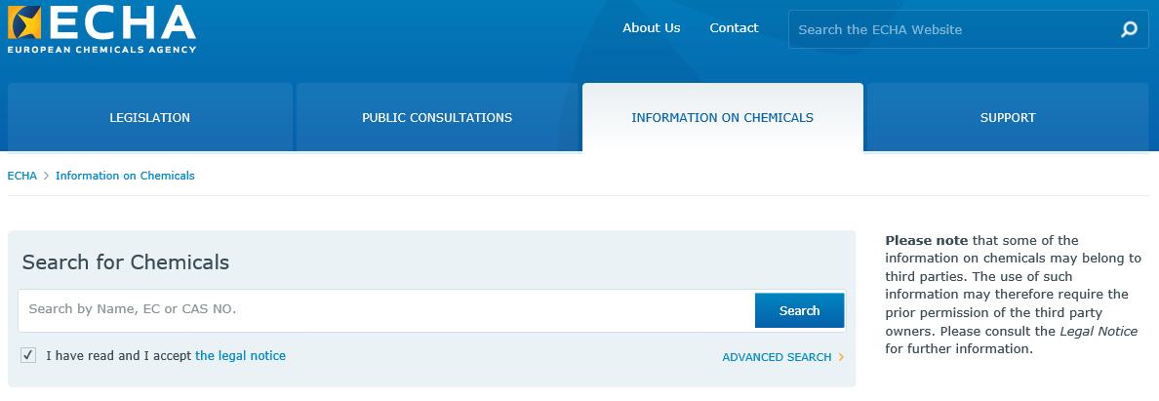
Information on the ECHA website
  InfoCards for user friendly overview
  Brief profile for substance properties
  Source data for detailed substance information
  Caveat: The submitted data is not verified by ECHA

Slide 28
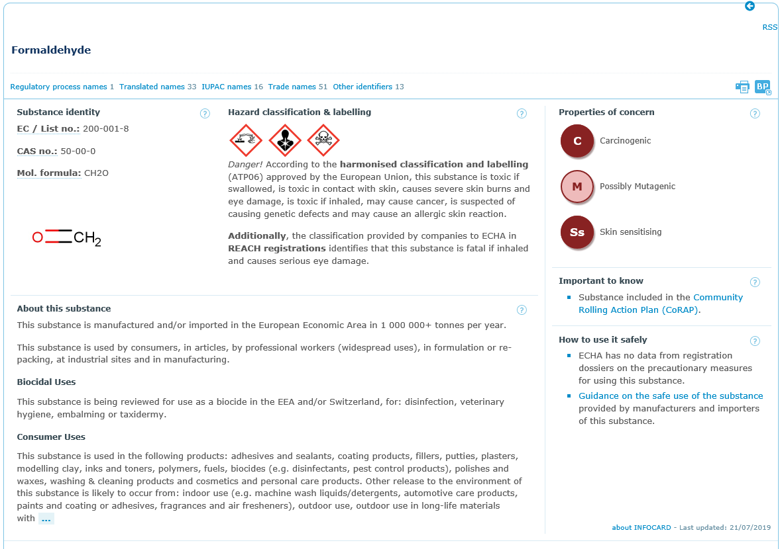
InfoCard – clear overview for all
echa.europa.eu/information-on-chemicals
Notes:
The InfoCard summarizes the non-confidential data on substances as it is held in the databases of the European Chemicals Agency (ECHA). The data is provided by industry and it is not manually verified by ECHA. The quantity and the quality of the information is the responsibility of industry (registrants and notifiers). The InfoCard is automatically generated; information requirements under different legislative frameworks may therefore not be fully up to date or complete.

Slide 29
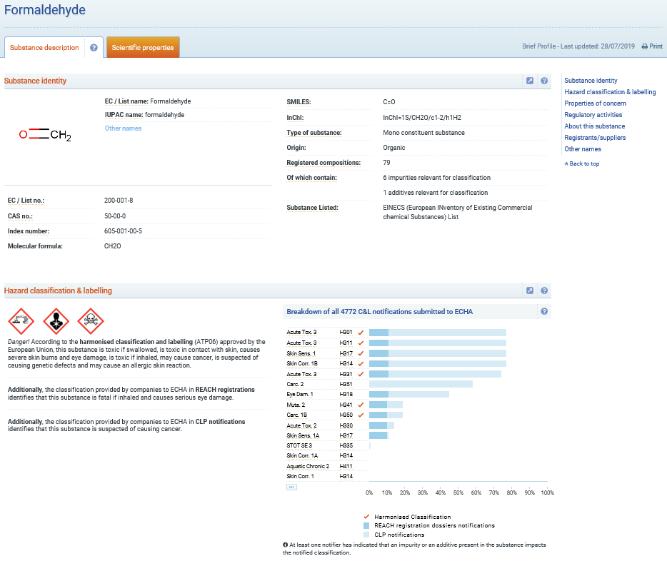
Brief Profile – Substance Description
Substance identity
Classification and labelling
Hazardous effects
Regulatory activities
Use of substance
Registrants/suppliers
echa.europa.eu/information-on-chemicals
Notes:
The Brief Profile summarizes the non-confidential data on substances as it is held in the databases of the European Chemicals Agency (ECHA), including data provided by third parties. The Brief Profile is automatically generated; note that it does not currently distinguish between harmonised classification and minimum classification; information requirements under different legislative frameworks may therefore not be fully up to date or complete.

Slide 30
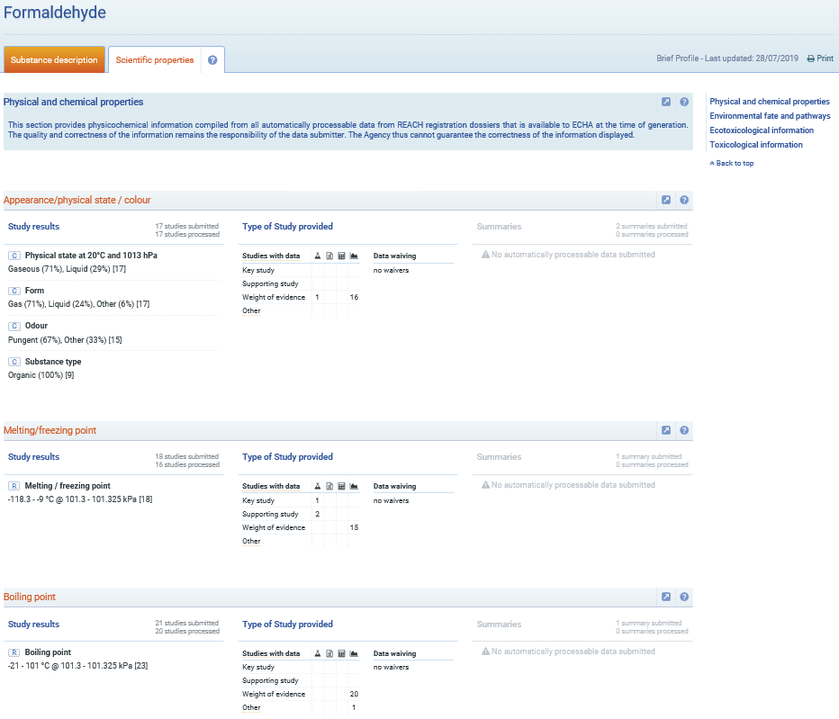
Brief Profile – Scientific Properties
Physical and chemical properties
Environmental fate and pathways
Ecotoxicological information
Toxicological information
echa.europa.eu/information-on-chemicals
Notes:
The Brief Profile summarizes the non-confidential data on substances as it is held in the databases of the European Chemicals Agency (ECHA), including data provided by third parties. The Brief Profile is automatically generated; note that it does not currently distinguish between harmonised classification and minimum classification; information requirements under different legislative frameworks may therefore not be fully up to date or complete.

Slide 31

Chemicals of Concern

Slide 32
Regulatory risk management of chemicals of concern
Authorities control risks at a regulatory level by identifying and regulating chemicals of concern under REACH and CLP. The typical approach is:
Identify chemical of concern
Analyse the risk management options
No action
Harmonised classification and labelling
Candidate List
Authorisation List
Restriction
Other legislation
Notes:
Substances with certain hazard properties can be of concern for human health and/or the environment. Authorities aim to identify and subsequently regulate such substances to make sure that the risks associated with their use are properly controlled. The regulatory mechanisms under REACH/CLP are authorisation, restriction and harmonised classification and labelling. A substance identified as a substance of very high concern (SVHC) is placed on the Candidate List, which is the first step in the authorisation procedure. See http://www.echa.europa.eu/candidate-list-table. There is an EU-wide commitment to have all relevant currently known substances of very high concern (SVHCs) included in the Candidate List by 2020, as described in the SVHC roadmap https://echa.europa.eu/substances-of-potential-concern.

Slide 33
Downstream users and chemicals of concern
Downstream users can look for safer alternatives to chemicals of concern. They can also help to ensure that the information available for decision-making on regulatory management options is reliable and realistic
Investigate substituting chemicals of concern with a safer alternative chemical or process
Provide your supplier with accurate information on your use and use conditions, either directly or through your supplier organisation. This ensures that registration dossiers are based on realistic information
Participate in public consultation, to make sure decisions are made on the best available information
Harmonised classification and labelling
Candidate List
Authorisation List
Restriction
Notes:
Downstream users are encouraged to follow this process and to give their contributions during the different consultation phases of the authorisation, restriction and harmonised classification and labelling processes.
A good starting point is the Public Activities Coordination Tool (PACT) . PACT lists the substances for which a Risk Management Option Analysis (RMOA) is either under development or has been completed since February 2013. https://echa.europa.eu/pact.

Slide 34

Overview of key actions for downstream users under
REACH and CLP

Slide 35

Obligations for downstream users on information in the supply chain
Implement appropriate risk management measures as provided by their supplier
Check exposure scenarios to ensure the use is covered and take appropriate action
Inform their suppliers on new information on hazards they may have and inappropriate risk management measures
Notes:
The main downstream user obligations are specified in Title V of the REACH regulation 1907/2006 . If a use is not covered in the exposure scenario, the downstream user should take appropriate action such as: request his supplier to include the use; change supplier; substitute the substance or process; prepare a downstream user chemical safety report. See the interactive guide on Safety Data Sheets (https://echa.europa.eu/safety-data-sheets-and-exposure-scenarios-guide) or the practical Guide 13 ”How downstream users can handle exposure scenarios” (https://echa.europa.eu/practical-guides) for more information.

Slide 36
Obligations for downstream users related to chemicals of concern
Use harmonised classification of substances when it is available
Check that chemicals are used in line with any restrictions or authorisations that may apply
If a substance of very high concern (SVHC) is incorporated in articles above 0.1% w/w, downstream users may need to notify ECHA or inform customers regarding safe use
Harmonised classification and labelling
Authorisation List
Restriction
Candidate List
Notes:
For more information on substances in articles see the guidance https://echa.europa.eu/documents/10162/23036412/articles_en.pdf.

Slide 37
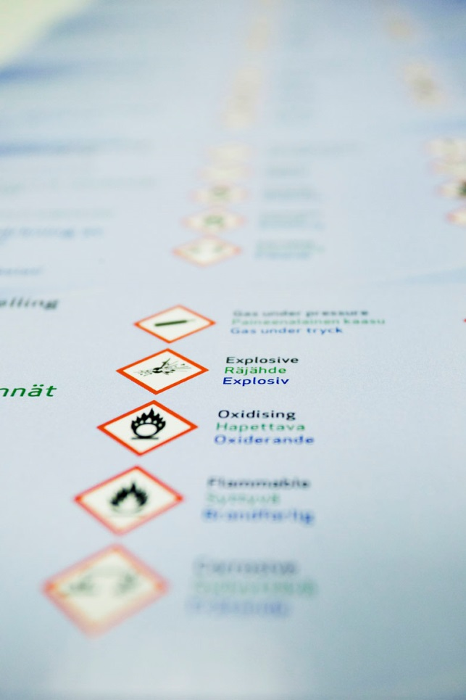
Obligations for downstream users who supply substances and mixtures
Classify, label and package substances and mixtures in accordance with CLP before placing them on the market
Derive the classification of the mixture, if formulating or changing the composition of a mixture
Classify the ingredient substances according to CLP and notify the C&L Inventory when importing a hazardous substance (if they contribute to the classification of the mixture)
Provide safety data sheet, exposure scenarios or other information as specified in REACH Title IV
Recommend relevant risk reduction measures to customers
Notes:
Supplier obligations are specified in CLP regulation 1272/2008 and Titles IV of the REACH regulation 1907/2006. The format of the SDS is specified in Annex II of REACH

Slide 38
REACH Registration – Tips for downstream users
Phased registrations are over but registration continues for substances new to the EEA market or to the importer/manufacturer
Review your chemical inventory regularly
Identify substances that are not yet registered by your suppliers
Contact your suppliers and ask them if they plan to register
Consult the REACH registration database and check if another supplier has registered the substance already
Check with your sector organisation about registration of substances for your sector. Check also that they have made registrants aware about how your sector uses their substances

Slide 39

REACH and CLP –
Benefits for downstream users
More and better information on chemical hazards
Improved communication in the supply chain regarding safe use
Downstream users can benefit from chemical safety assessments undertaken by suppliers for
  Environment
  Workers
  Consumers

Slide 40
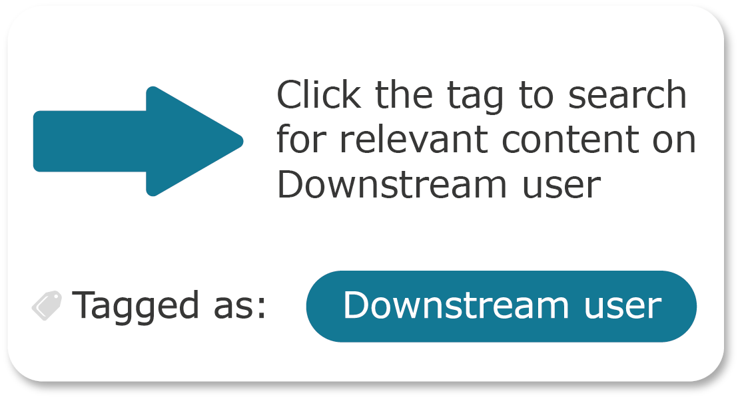
Information for Downstream users on the ECHA website
The technical, scientific and administrative aspects of REACH and CLP are managed by ECHA, the European Chemicals Agency.
Web pages containing information specifically aimed at Downstream users have been tagged “Downstream user”. Click the tag to retrieve the list of relevant content.
echa.europa.eu/regulations/reach/downstream-users
Notes:
For more general information on REACH and CLP, consult the ECHA website at echa.europa.eu

Slide 41

Information to consumers
https://chemicalsinourlife.echa.europa.eu/

